Slide 1

Git Hub
Time Series

Slide 2
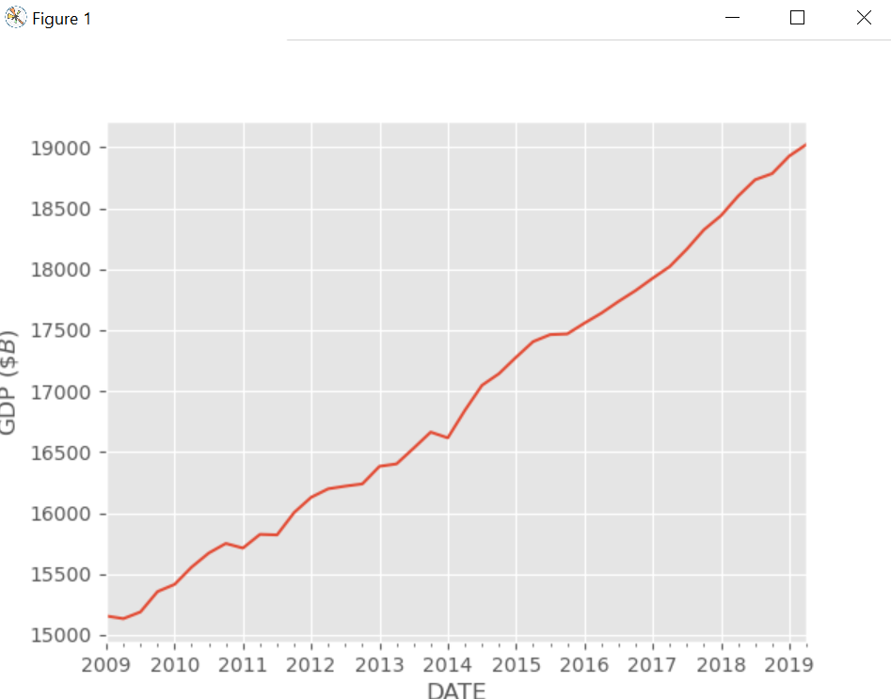
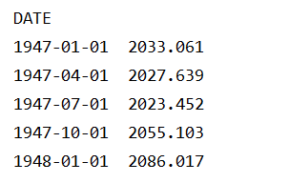
Notes:
import pandas as pd import scipy.stats as stats from collections import Counter from matplotlib import pyplot from imblearn.over_sampling import SMOTE from sklearn.preprocessing import LabelEncoder from sklearn.model_selection import cross_val_score from sklearn.model_selection import RepeatedStratifiedKFold from sklearn.ensemble import RandomForestClassifier import numpy as np from imblearn.over_sampling import SMOTE from imblearn.pipeline import Pipeline from sklearn.linear_model import LinearRegression, LogisticRegression from sklearn import preprocessing from sklearn.model_selection import train_test_split, GridSearchCV from sklearn.tree import DecisionTreeClassifier from sklearn.metrics import r2_score, classification_report, confusion_matrix, accuracy_score, roc_auc_score, roc_curve, precision_recall_curve, average_precision_score from sklearn.metrics import homogeneity_score, silhouette_score from sklearn.ensemble import RandomForestClassifier, VotingClassifier from sklearn.preprocessing import MinMaxScaler import matplotlib.pyplot as plt from sklearn.ensemble import RandomForestClassifier from tabulate import tabulate from matplotlib.dates import DateFormatter, DayLocator import statsmodels.api as sm import seaborn as sns from datetime import datetime # Import statsmodel from scipy import stats import statsmodels.api as sm import statsmodels.formula.api as smf from statsmodels.tsa.stattools import adfuller # Import StratifiedKFold from sklearn.model_selection import StratifiedKFold from sklearn.model_selection import train_test_split,StratifiedShuffleSplit, StratifiedKFold from sklearn.preprocessing import OneHotEncoder from sklearn.preprocessing import LabelEncoder # Set some parameters to get good visuals - style to ggplot and size to 15,10 plt.style.use('ggplot') #plt.rcParams['figure.figsize'] = (15, 10) from sklearn.preprocessing import OneHotEncoder from sklearn.compose import ColumnTransformer from pandas_profiling import ProfileReport import pandas as pd import seaborn as sns import matplotlib.pyplot as plt import pandas as pd import seaborn as sns import matplotlib.pyplot as plt from sklearn.datasets import make_classification from pandas import DataFrame from pandas import Series import pymannkendall as mk import matplotlib.pyplot as plt import statsmodels.api as sm from pandas import DataFrame import matplotlib import matplotlib.pyplot as plt import numpy as np import pandas as pd GDP = pd.read_csv('GDP.csv', parse_dates=['DATE']) GDP.set_index('DATE', inplace=True) print(GDP.head())

Slide 3
Percentage of deaths attributed to Influenza and Pneumonia in the past 8 years
Notes:
#percentage of deaths attributed to Influenza and Pneumonia in the past 8 years Infl = pd.read_csv('CDC.csv') print(Infl.head()) # Adding date Infl['date'] = Infl['Year']+Infl['Week']/52. Infl.plot(x='date', y=['Percent of Deaths Due to Pneumonia and Influenza', 'Expected', 'Threshold']) ax = plt.gca() ax.legend(['Mortality', 'Expected', 'Threshold']) ax.set_xlabel('Date') ax.set_ylabel('% Mortality') plt.show()

Slide 4
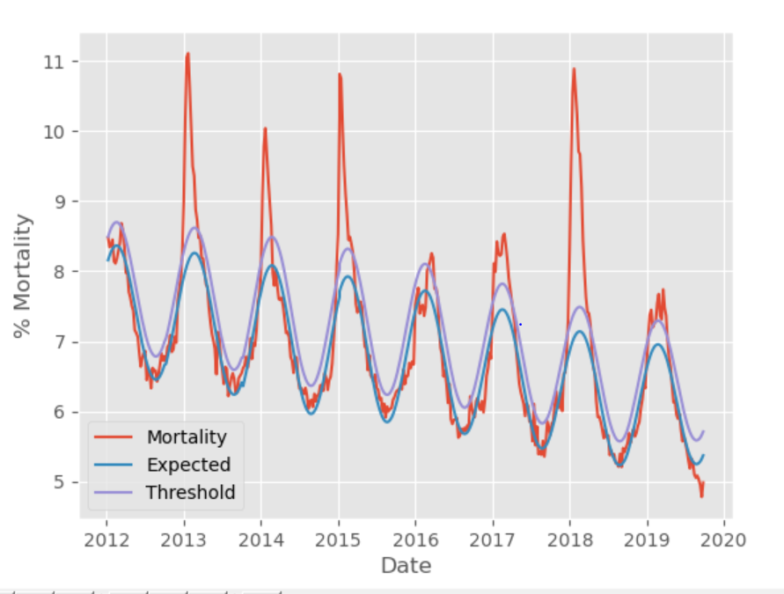
The seasonal behavior in eye catching The purple curve tells us the expected seasonal behavior, while the green curve shows the threshold above which there is this epidemic

Slide 5
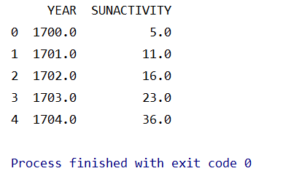
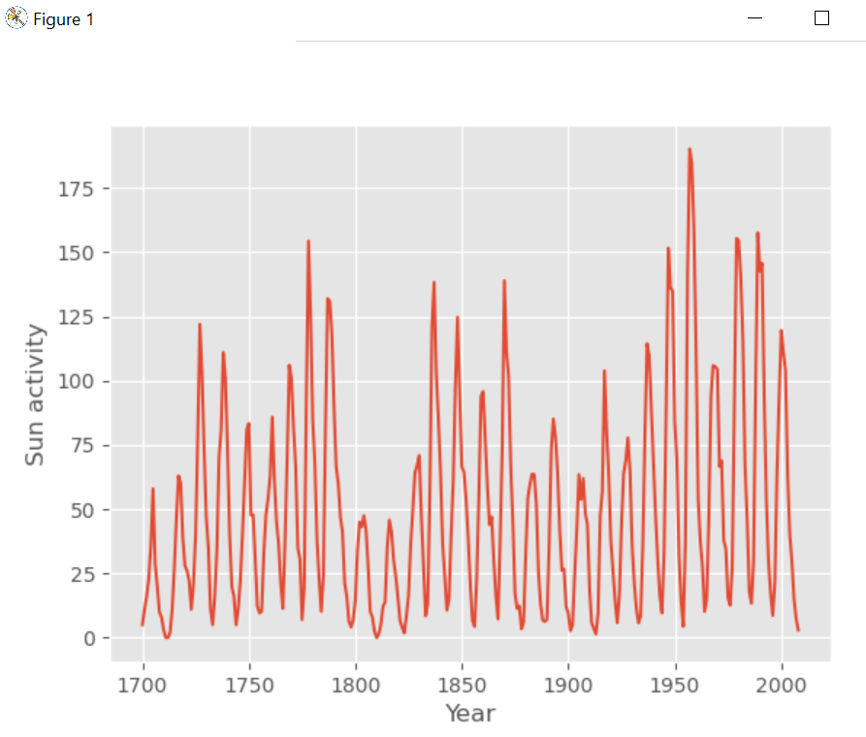
Sun spots in 300 years shows seasonal behavior
Notes:
S = pd.read_csv('sun.csv') print(S.head())
S.plot(x='YEAR', y='SUNACTIVITY', legend=False) ax = plt.gca() ax.set_ylabel('Sun activity') ax.set_xlabel('Year') plt.show()

Slide 6
Airline

Slide 7
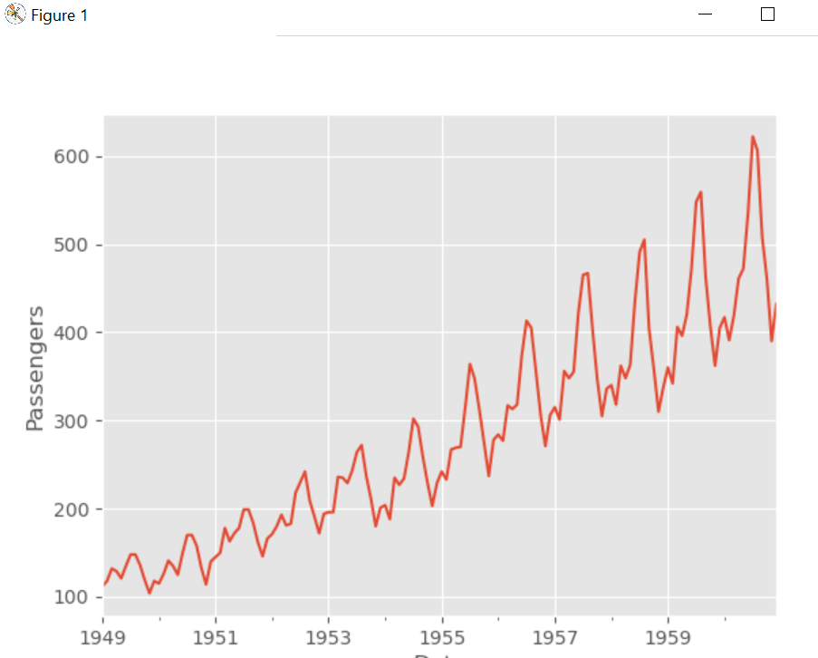
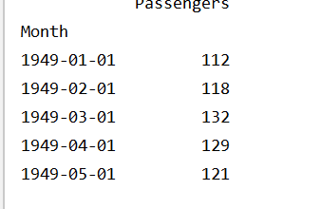
Notes:
airline = pd.read_csv('nternational-airline-passengers.csv', sep=‘;’)
airline['Month'] = pd.to_datetime(airline['Month']+'-01')
airline.set_index('Month', inplace=True) print(airline.head()) airline.plot(legend=False) ax = plt.gca() ax.set_xlabel('Date') ax.set_ylabel('Passengers') plt.show()

Slide 8
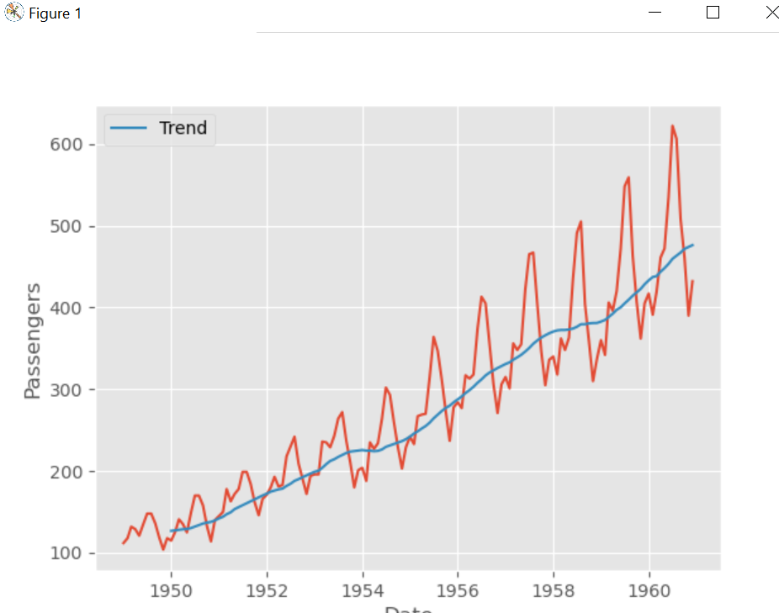
Identify the trending by taking a running average.
Runs over the entire dataset one step at a time and calculates the average value within each window. Now we add the trend line to the previous plot
Notes:
def running_average(x, order): current = x[:order].sum() running_avg = [] for i in range(order, x.shape[0]): current += x[i] current -= x[i - order] running_avg.append(current / order) return np.array(running_avg) trend = running_average(airline['Passengers'], 12) fig, ax = plt.subplots(1, 1) ax.plot(airline.index, airline['Passengers']) ax.set_xlabel('Date') ax.set_ylabel('Passengers') ax.plot(airline.index[12:], trend, label='Trend') ax.legend() plt.show()

Slide 9
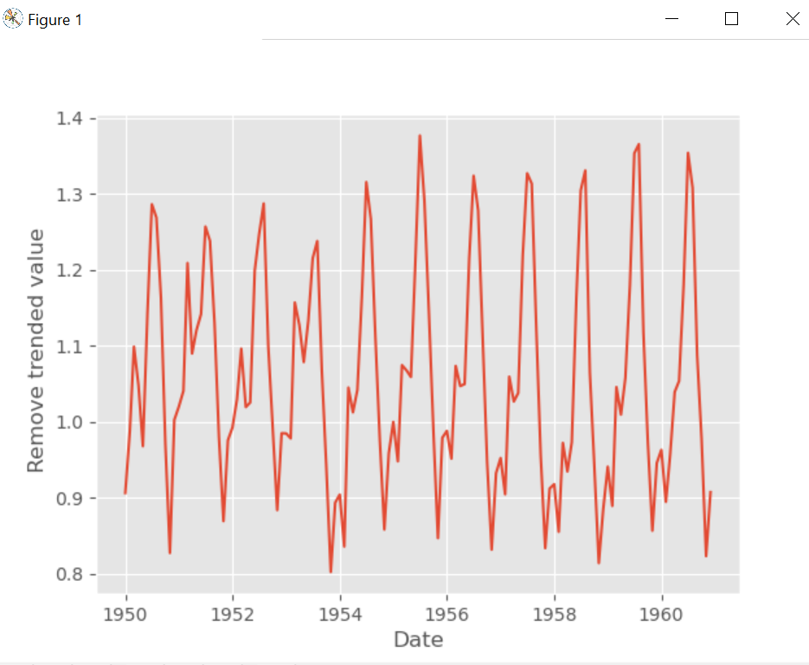
Removed Trend
Removetrend = airline.iloc[12:].values.flatten()/trend fig, ax = plt.subplots(1, 1) ax.plot(airline.index[12:], Removetrend) ax.set_xlabel('Date') ax.set_ylabel(' Remove trended value') plt.show()

Slide 10
Sometimes it would be beneficial to remove the trend from our data, especially if it is quite pronounced (as seen in prev screenshot), so we can assess the seasonal variation or the noise in our time series. Removing the trend (or de-trending) can also simplify the modeling process and improve model performance.
A time series with a trend is called non-stationary. A time series that does not have a trend or has the trend removed is said to be stationary.
Detrended time series is used as input for learning algorithms such as ARIMA (Python library for analyzing and forecasting time series data) or it can also be used as an additional input for a machine learning algorithm.

Slide 11
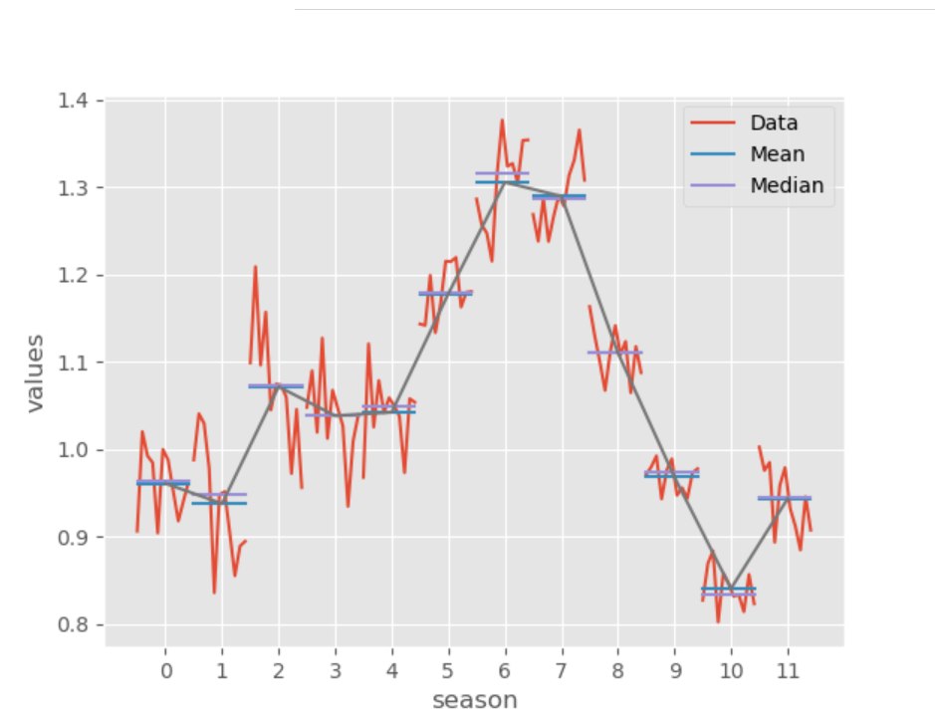
Seasonal Subplot
Clear Seasonality ca be seen
Notes:
#seasonal pattern analysis using seasonal subplots def seasons(Removetrend, order, plot_mean=True): colors = plt.rcParams['axes.prop_cycle'].by_key()['color'] N = len(Removetrend) Data = np.array([Removetrend[i::order] for i in range(order)]) Mean = np.mean(Data, axis=1) Median = np.median(Data, axis=1) counts = [0] counts.extend([len(Data[i]) for i in range(order)]) counts = np.cumsum(counts) ticks = (counts[:-1] + counts[1] / 2) for i in range(order): values = Data[i, :] npoints = len(values) plt.plot(range(counts[i], counts[i + 1]), values, c=colors[0]) plt.plot(range(counts[i], counts[i + 1]), np.ones(npoints) * Mean[i], c=colors[1]) plt.plot(range(counts[i], counts[i + 1]), np.ones(npoints) * Median[i], c=colors[2]) plt.legend(['Data', 'Mean', 'Median']) plt.xlabel('season') plt.ylabel('values') plt.xticks(ticks, np.arange(order)); if plot_mean: plt.plot(ticks, Mean, c=colors[3]) return Mean Mean = seasons(Removetrend, 12) plt.show()

Slide 13
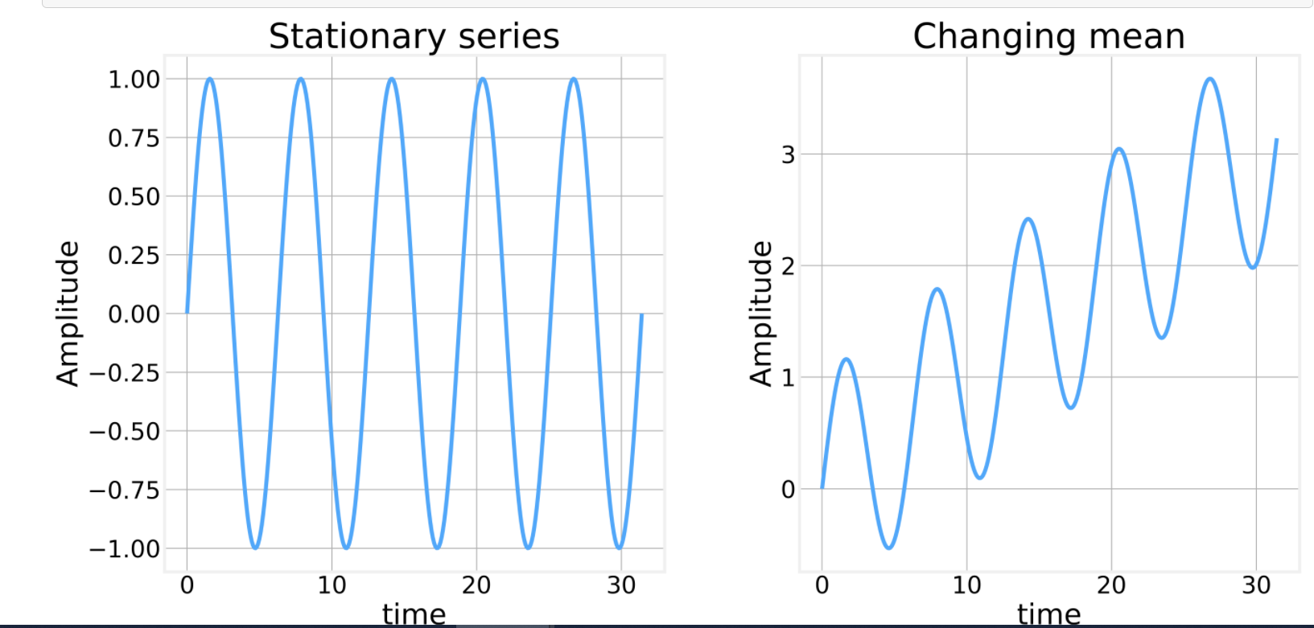
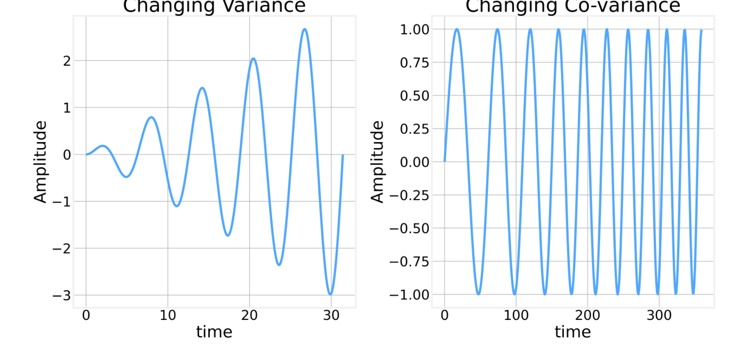
Types

Slide 14
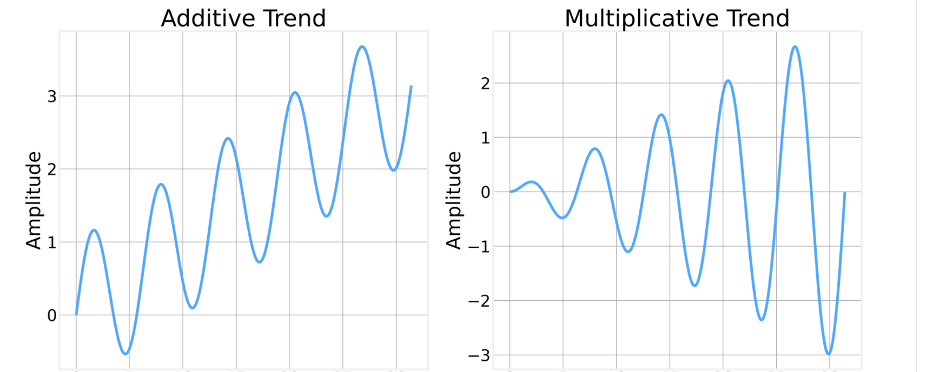

Slide 15
Transformations

Slide 16
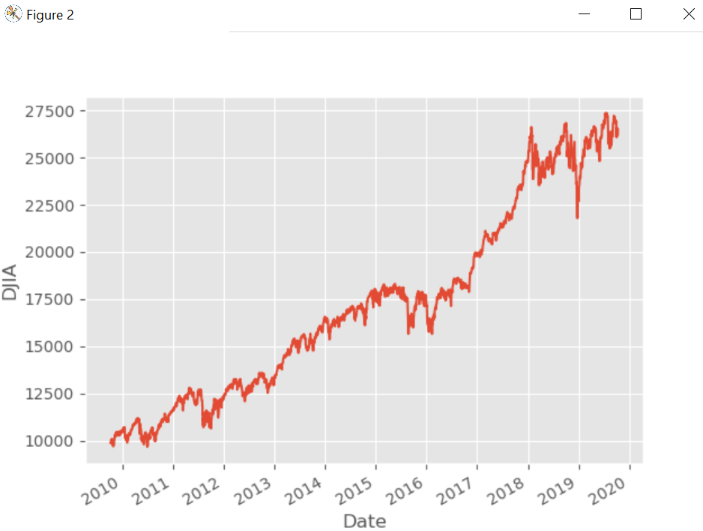
Typical transformations and data manipulations that are common in time series analysis. The Dow-Jones Industrial Average dataset
Notes:
DJ = pd.read_csv('DJIA.csv', parse_dates=['DATE'], na_values='.').dropna() DJ.plot(x='DATE', legend=False) ax = plt.gca() ax.set_ylabel('DJ') ax.set_xlabel('Date') plt.show()

Slide 18
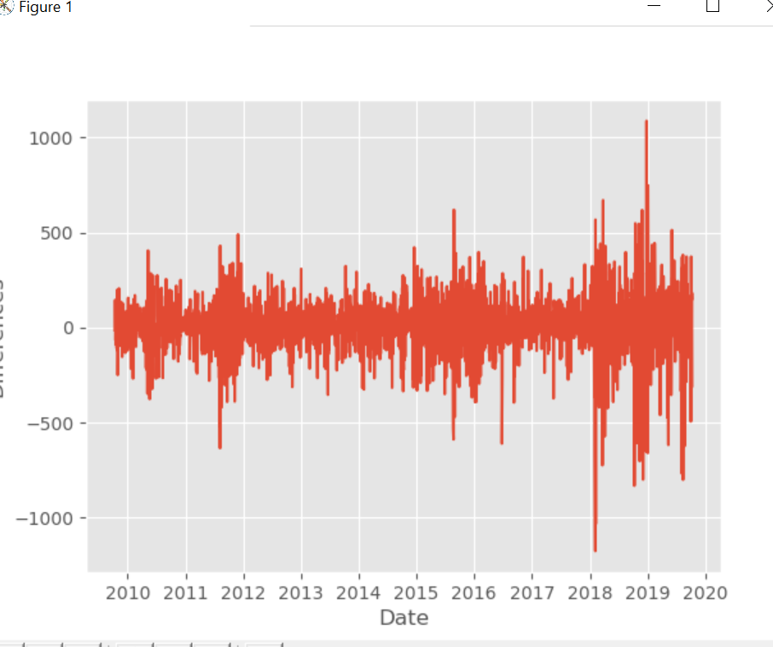
Differences
Removing the trend from a dataset is to differentiate it. Since we are dealing with discretized datasets this is the same as using finite differences.
Notes:
def differentiate(values, d=1): # First value is required so that we can recover the original values with np.cumsum x = np.concatenate([[values[0]], values[1:]-values[:-1]]) if d == 1: return x else: return difference(x, d - 1) values = Dow['DJIA'].values differences = differentiate(values) plt.plot(Dow['DATE'].iloc[1:], differences[1:]) plt.xlabel('Date') plt.ylabel('Differences') plt.show()

Slide 19
To recover we can just integrate
Notes:
reb = integrate(differences)

Slide 20
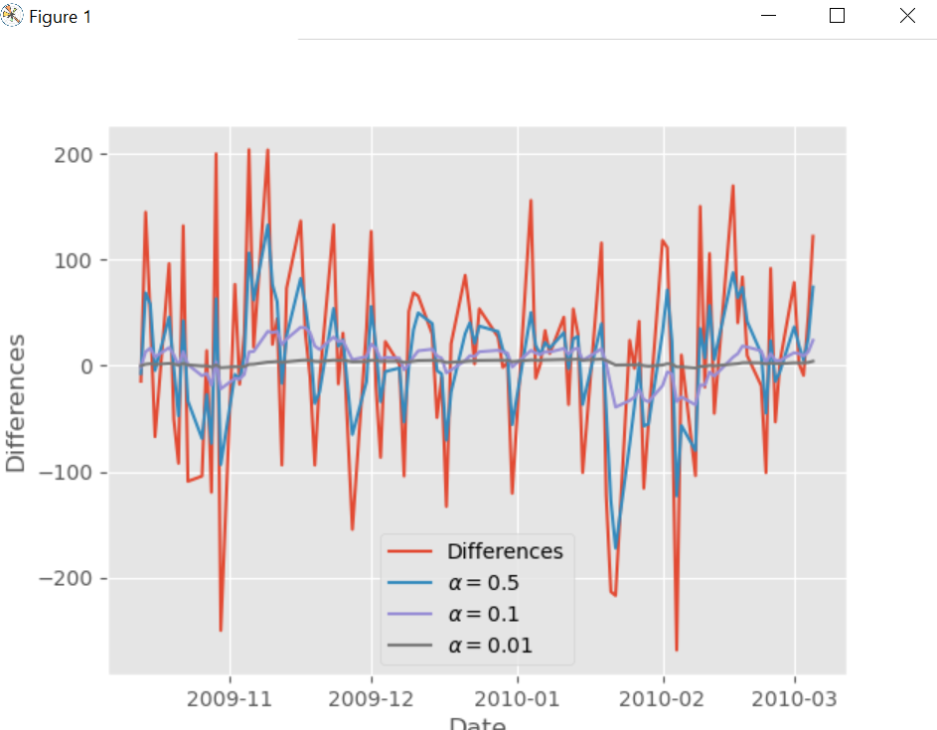
Exponential Smoothing
exponentially weighted running average where past values get exponentially reduced.
smaller the value of alpha the smoother (less noisy) the result
Notes:
def Exp(values, alpha=0.05): N = len(values) S = [values[0] * alpha] for i in range(1, N): S.append(alpha * values[i] + (1 - alpha) * S[-1]) return np.array(S) smooth = [] smooth.append(Exp(differences[1:], 0.01)) smooth.append(Exp(differences[1:], 0.1)) smooth.append(Exp(differences[1:], 0.5)) plt.plot(Dow['DATE'].iloc[1:100], differences[1:100], label='Differences') plt.plot(Dow['DATE'].iloc[1:100], smooth[2][:99], label=r'$\alpha=0.5$') plt.plot(Dow['DATE'].iloc[1:100], smooth[1][:99], label=r'$\alpha=0.1$') plt.plot(Dow['DATE'].iloc[1:100], smooth[0][:99], label=r'$\alpha=0.01$') plt.xlabel('Date') plt.ylabel('Differences') plt.legend() plt.show()

Slide 21
Resampling
In many cases we also need to change the frequency at which we are operating. For example, our DJIA dataset has end of day values, but we might be interested in weekly or monthly data points. Resampling is a series of techniques designed to deal with this situation and is similar in spirit to the windowing technique. The main difference is that instead of simply moving the window at a fixed step we have each window correspond to our period of interest.

Slide 22
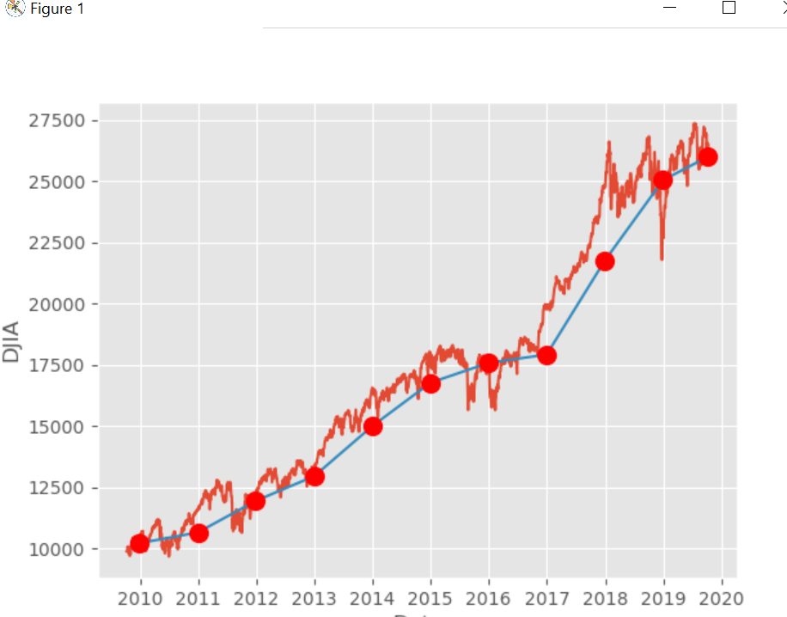
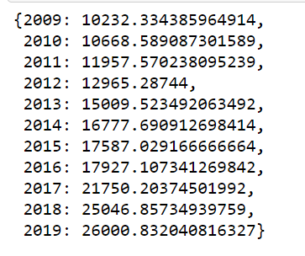
Resampled-GroupBy function is useful not only for resampling but also for wide range of statistical analysis.
Agg
Notes:
mapping = Dow['DATE'].dt.year values = Dow['DJIA'].values def groupBy(values, mapping, func=None): agg = {} pos = {} for i in range(values.shape[0]): key = mapping.iloc[i] if key not in agg: agg[key] = [] pos[key] = i if not np.isnan(values[i]): agg[key].append(values[i]) order = sorted(agg.keys()) if func is not None: for key in agg: agg[key] = func(np.array(agg[key]).astype('float')) return agg, pos #roupBy function is useful not only for resampling but also for wide range of statistical analysis. In addition to a mapping, we must also specify what aggregation function we want to use. Are we interested in the average value? the maximum? standard deviation? agg, pos = groupBy(values, mapping, np.mean) aggregated = [] for key in pos: aggregated.append([pos[key], agg[key]]) aggregated = np.array(aggregated) plt.plot(Dow['DATE'], Dow['DJIA']) ax = plt.gca() ax.plot(Dow.set_index('DATE').index[aggregated.T[0].astype('int')], aggregated.T[1]) ax.plot(Dow.set_index('DATE').index[aggregated.T[0].astype('int')], aggregated.T[1], 'ro', markersize=10,) ax.set_ylabel('DJIA') ax.set_xlabel('Date') plt.show()

Slide 23
AutoCorrelation

Slide 24
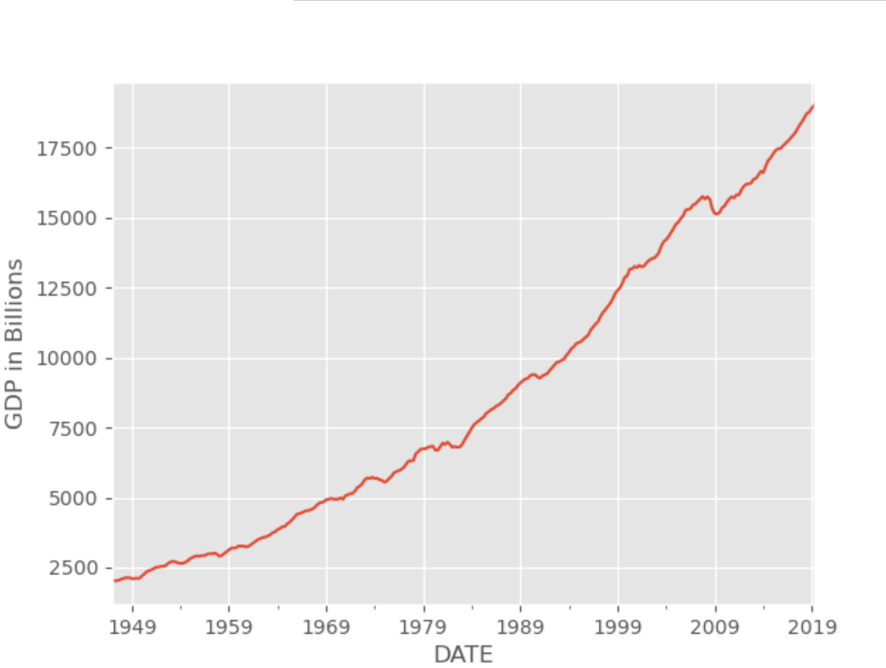
Notes:
####################### Auto Correlation GDP = pd.read_csv('GDP.csv', parse_dates=['DATE']) GDP.set_index('DATE', inplace=True) ax=GDP.plot(legend=False) ax.set_ylabel(r'GDP in Billions') values = GDP['GDP'].values Removetrend = values[1:]-values[:-1] from statsmodels.graphics import tsaplots tsaplots.plot_acf(values) plt.show() plt.plot(GDP.index[1:], Removetrend) plt.xlabel('DATE') plt.ylabel(r'Q Change In Billions') tsaplots.plot_acf(Removetrend) plt.show()

Slide 25
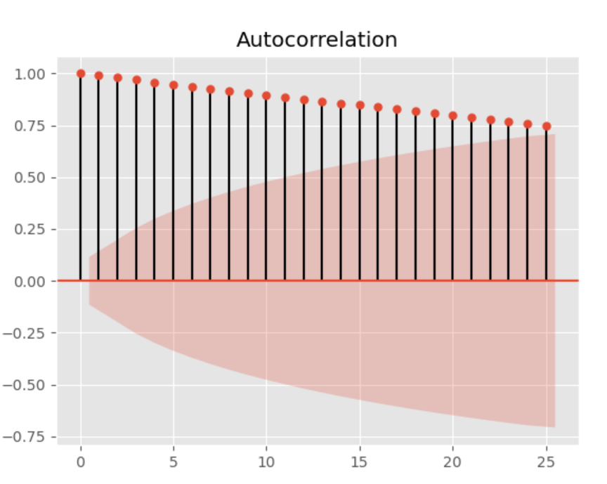
Since the series has a very strong trend, the auto-correlation function appears to be significant for very long periods. This is one more indication that we must detreend the data

Slide 26
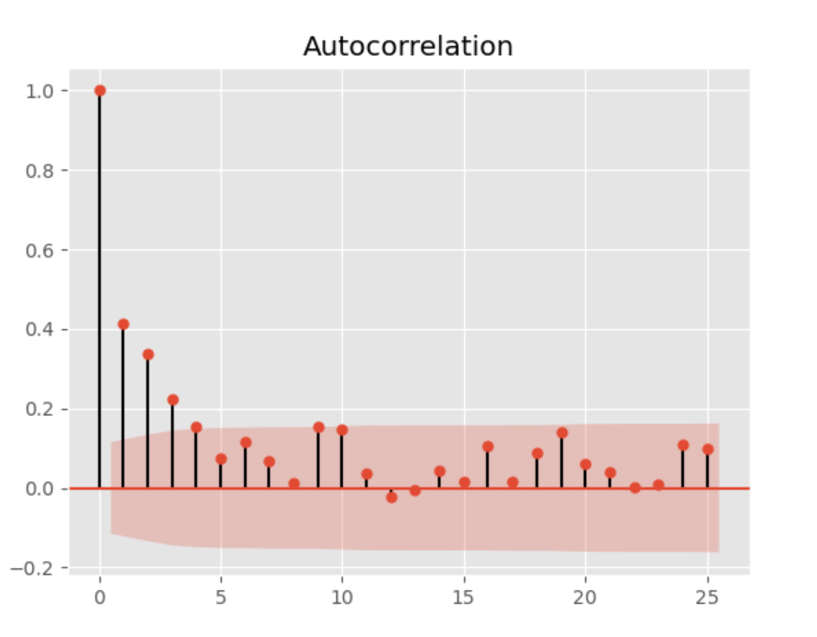

Slide 27
Dickey Fuller Test
To Check for Stationarity

Slide 28
Classically, you should make your time series stationary. However, there are cases where unknown nonlinear relationships cannot be determined by classical methods. This information can be a source of information when building machine learning models. Non-stationary information can be used in feature engineering and feature selection.
Checks for Stationarity
Look at Plots: plot a run sequence plot to see anything with an obvious trend or seasonal effects
Summary Statistics: partition your data into intervals and check for obvious or significant differences in summary statistics
Statistical Test: use statistical tests if the expectations of stationarity are met or violated
Airline Passengers Dataset
data source

Slide 29
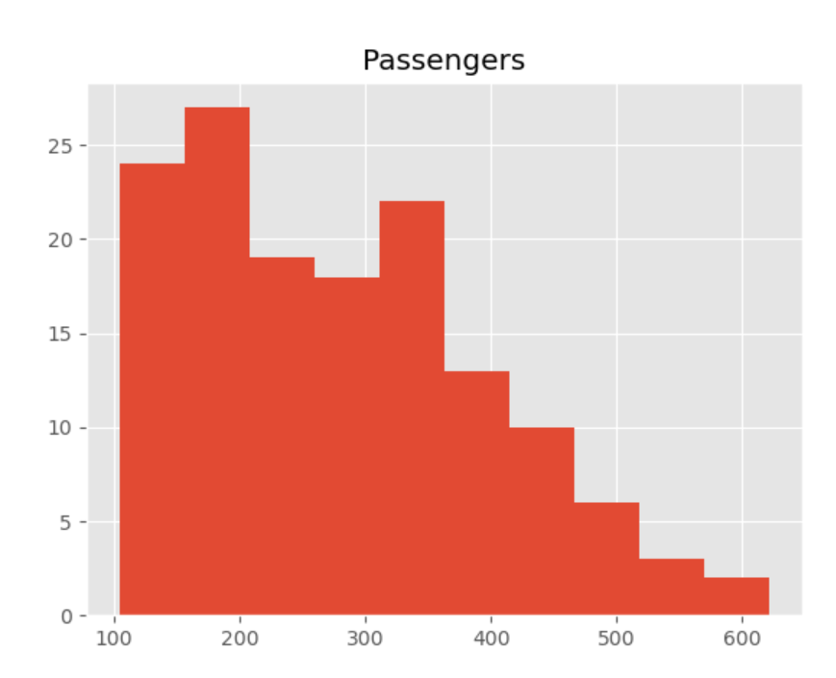
Airline –Inc Trend,
if the data is stationary the summary statistics should be consistent over time. The mean should be consistent with a consistent variance indicating a Gaussian distribution. The histogram does not show Gaussian distribution and another indication of non-stationary time series data.

Slide 30
ADF tests the null hypothesis that a unit root is present in time series sample. ADF statistic is a negative number and more negative it is the stronger the rejection of the hypothesis that there is a unit root. Null Hypotehsis (H0): If accepted, it suggests the time series has a unit root, meaning it is non-stationary. It has some time dependent structure. Alternate Hypothesis (H1): The null hypothesis is rejected; it suggests the time series does not have a unit root, meaning it is stationary. p-value > 0.05: Accept H0, the data has a unit root and is non-stationary p-value ≤ 0.05: Reject H0. the data does not have a unit root and is stationary

Slide 31
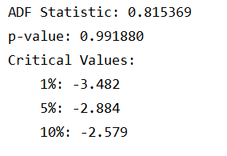
More negative ADF Statistic is the more likely we reject H0. In this case the stat is positive and way above any critical values. p-value is also way above 0.05 and we cannot reject H0. The data has a unit root and is non-stationary.

Slide 32
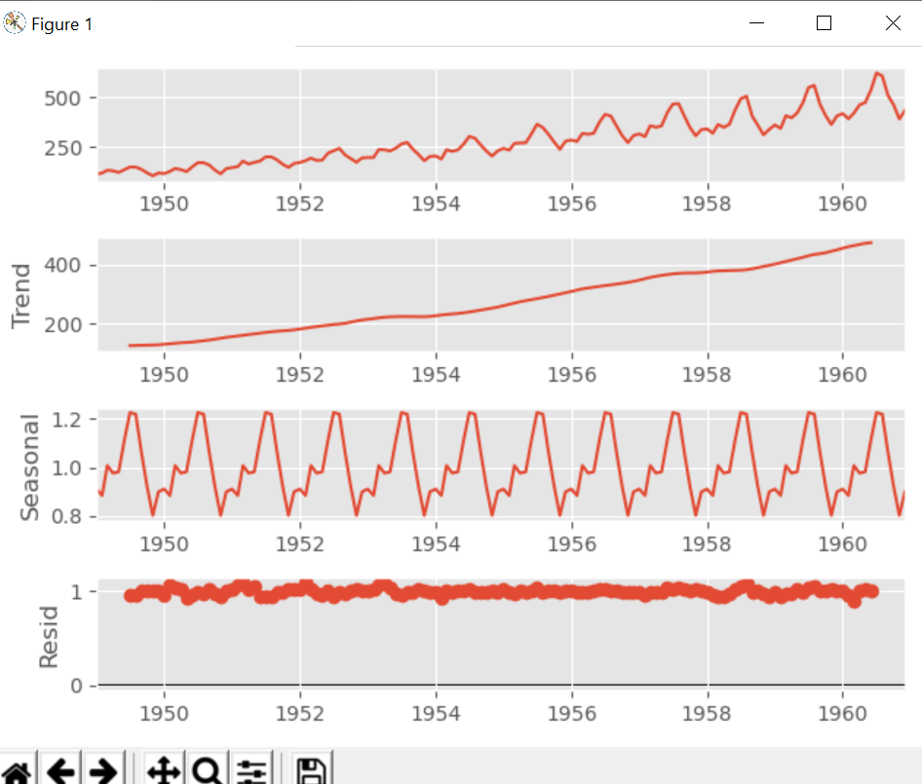
Notes:
esult = seasonal_decompose(airline, model='multiplicative') result.plot() pyplot.show() series = pd.read_csv('international-airline-passengers.csv', sep=';') split_point = len(series) - 12 dataset, validation = series[0:split_point], series[split_point:] print('Train-Dataset: %d, Validation-Dataset: %d' % (len(dataset), len(validation))) dataset.to_csv('dataset.csv', header=False) validation.to_csv('validation.csv', header=False)

Slide 33
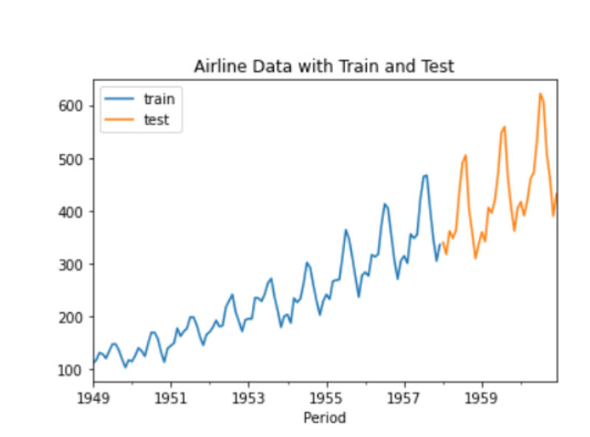
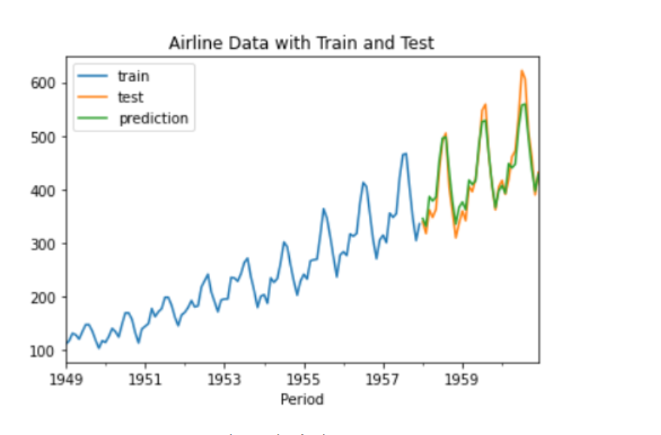
SKTIME ARIMA
Notes:
After developing the model, we would try to predict the next 3 years of data and compare it with the test data. the developed model can read the pattern quite well.
from sktime.datasets import load_airline from sktime.forecasting.model_selection import temporal_train_test_split # from sktime.utils.plotting.forecasting import plot_ysy = load_airline() y_train, y_test = temporal_train_test_split(y)plt.title('Airline Data with Train and Test') y_train.plot(label = 'train') y_test.plot(label = 'test') plt.legend()
from sktime.forecasting.arima import AutoARIMA forecaster = AutoARIMA(sp=12) forecaster.fit(y_train)
#Prediction fh = np.arange(1, 37) y_pred = forecaster.predict(fh)#Test and Prediction Plotting plt.title('Airline Data with Train, Test, and Prediction') y_train.plot(label = 'train') y_test.plot(label = 'test') y_pred.plot(label = 'prediction') plt.legend()

